Slide 1


The meaning of blockchain
and China’s development in blockchain
Speaker：Е Хэн
Group：P33111

Slide 2


CONTENTS
PART 1
Definition
PART 2
Mechanism
PART 3
Dangers and risk
PART 4
Application of blockchain in China

Slide 3

PART 1 Definition
What is the blockchain？

Slide 4



Village
A pay $10 to buy some books from B
Person A
Person B

Slide 5





Person A - $10
Person B + $10

Slide 6

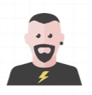
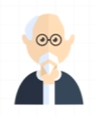

Person A - $10
Person A - $10
Person B + $10
Person B + $10
Person A - $10
Person A - $10
Person B + $10
Person B + $10

Slide 7


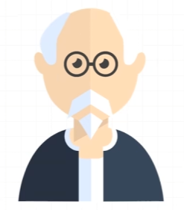

Person C

Slide 8

block 1 block 2 block 3
date:
1.1.2024
date:
2.1.2024
date:
3.1.2024

Slide 9

block 1 block 2 block 3
date:
1.1.2024
date:
2.1.2024
date:
3.1.2024

Slide 10

Person A has $50
Salary + $100
Buy books - $10
Taxi - $5
Lunch - $10
Left: $125
Person C

Slide 11


1.1.2024
2.1.2024
3.1.2024
opening balance
opening balance
opening balance
Ending balance
Ending balance
Ending balance

Slide 12
How does he get his income?
Person C

Slide 13
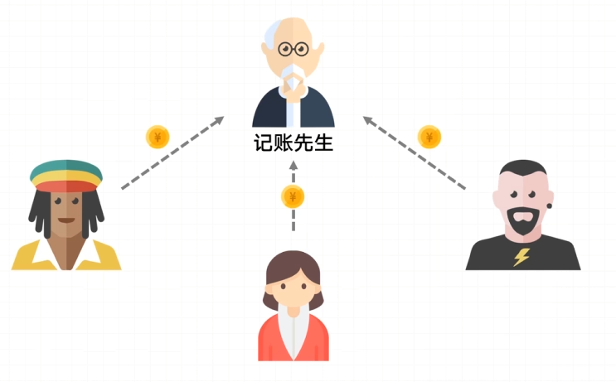
Example: One dollar as handling fee

Slide 14
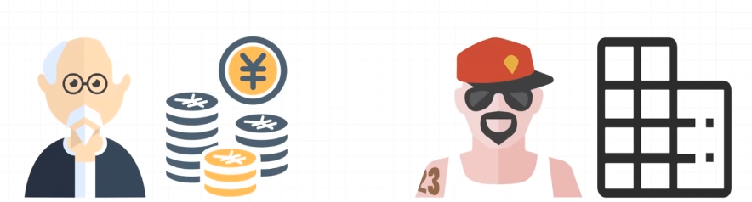
Income: $500 Income: $100

Slide 15

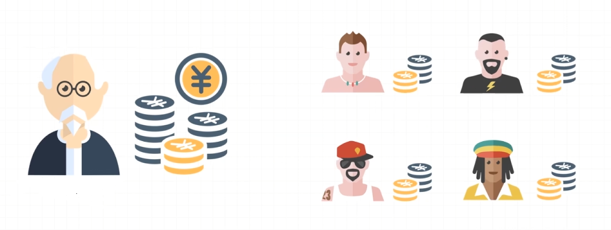
Election mechanism

Slide 16
PART 2 Mechanism

Slide 17
consensus mechanism
Ensuring that nodes in the network can agree on a set of transactions without a central authority
(everyone reaches consensus)

Slide 18
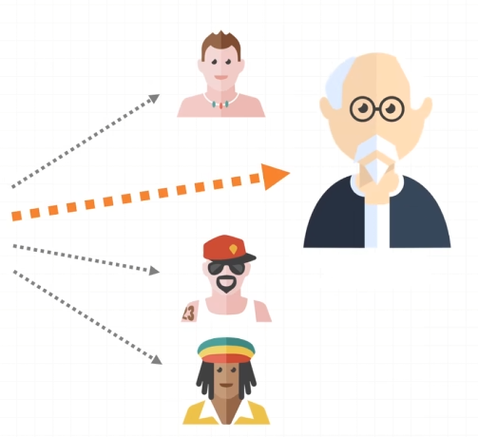
With the help of consensus mechanism
Improve efficiency
safety
Simplify operations
ensure consistency

Slide 19
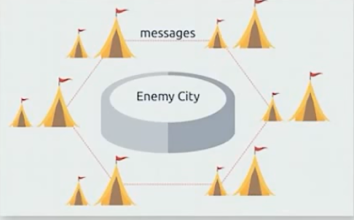
Byzantine Generals Problem
During the war, all generals in the Byzantine army must reach a consensus and decide whether to attack the enemy's camp.
But there may be traitors and enemy spies in the army

Slide 20
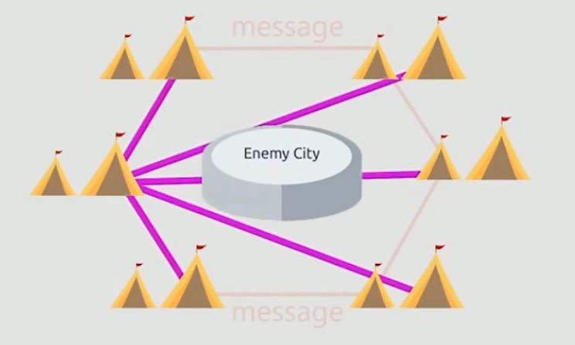
PBFT（Practical Byzantine Fault Tolerance）
Leverage the number of communications in exchange for reliability

Slide 21
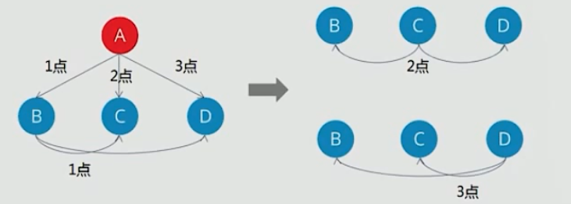
If there are two traitors, there is no solution，so let's say there's a traitor
If A is traitor，B、C、D will receive three different information, so A is the traitor

Slide 22
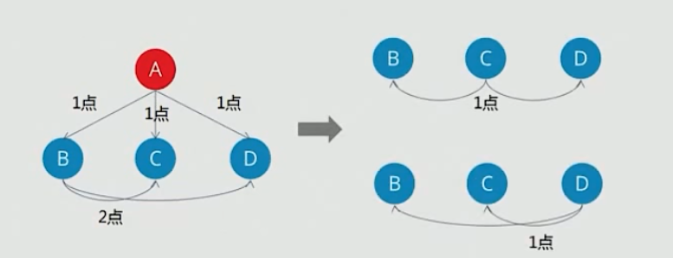
If there are two traitors, there is no solution，so let's say there's a traitor
If B is traitor，C、D will receive 2 identical instructions and one different instruction
So B is a traitor
When there are N invalid nodes, as long as the total number of nodes exceeds 3N, the correctness of the message can be guaranteed

Slide 23


The consensus mechanism used by Bitcoin - POW
（proof of work）
And how to proof the computer is hard working
Bitcoin is a P2P form of digital currency

Slide 24
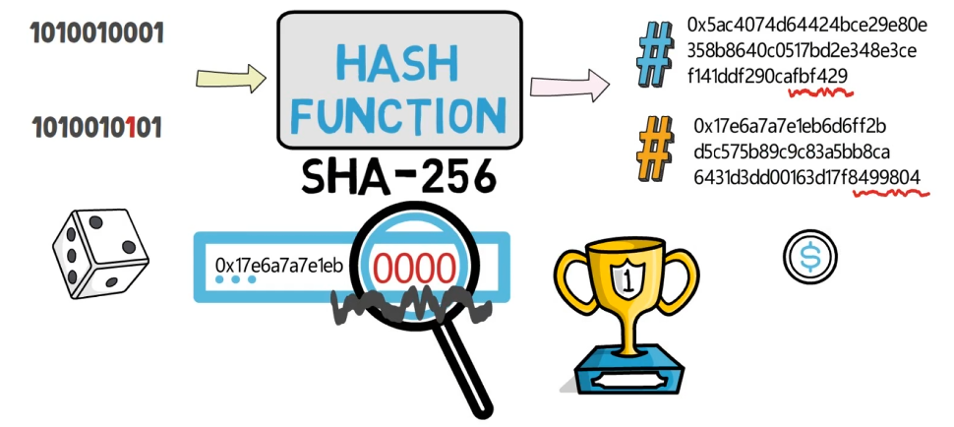

Slide 25
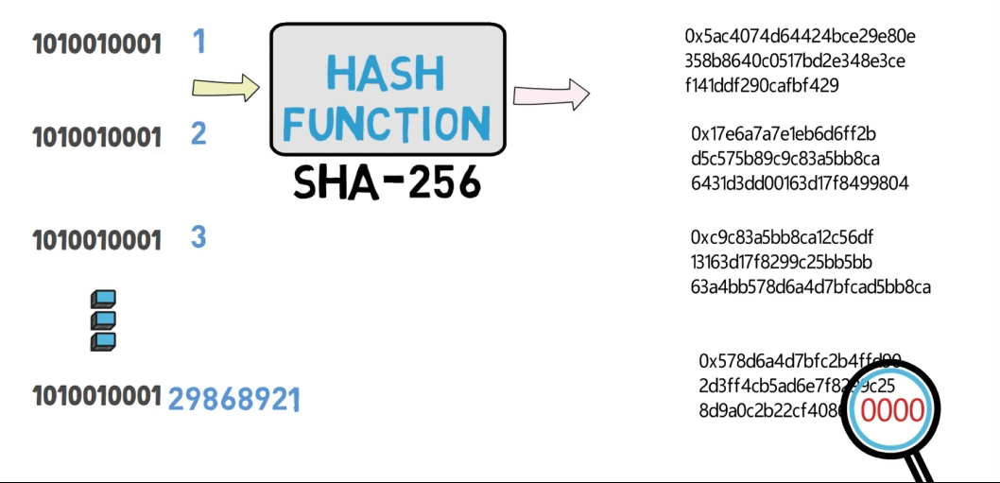

NONCE can reflect the real workload.
The process of constantly searching for NONCE is also called "mining"

Slide 26
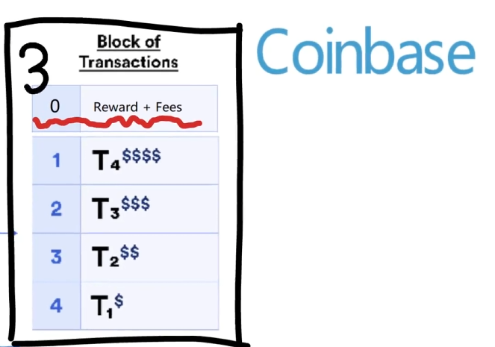
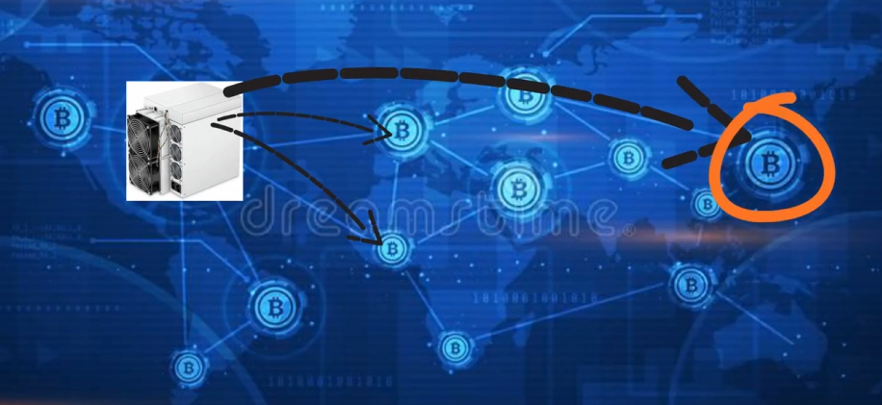

Slide 27
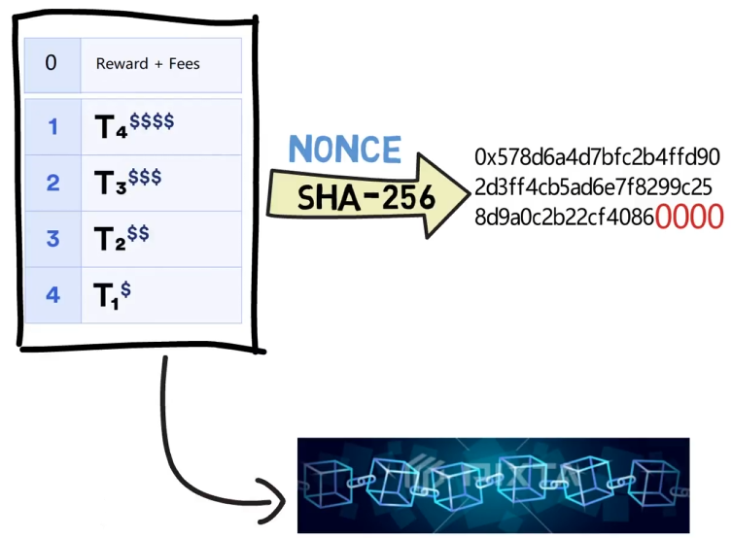
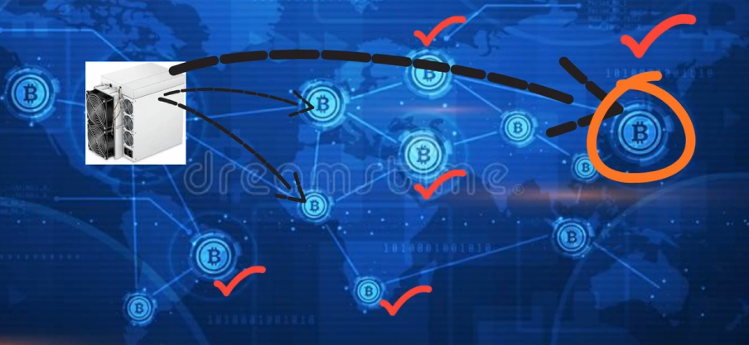

Slide 28
PART 3 Dangers

Slide 29
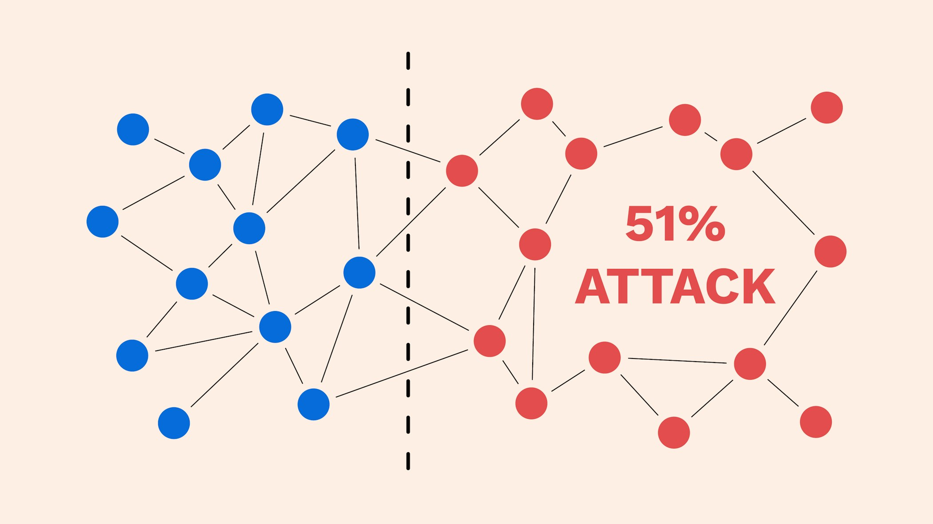

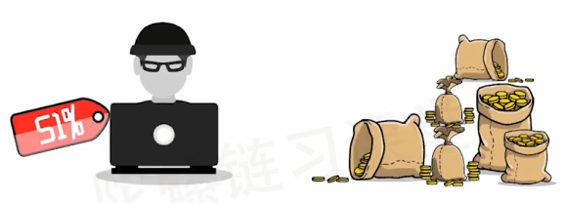
If honest nodes are larger than malicious nodes, then it is safe.
Otherwise, there is a possibility of being attacked.
This attack we call a “51% attack”

Slide 30
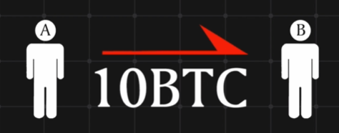
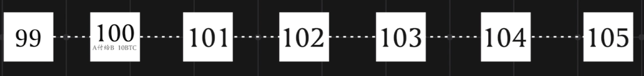
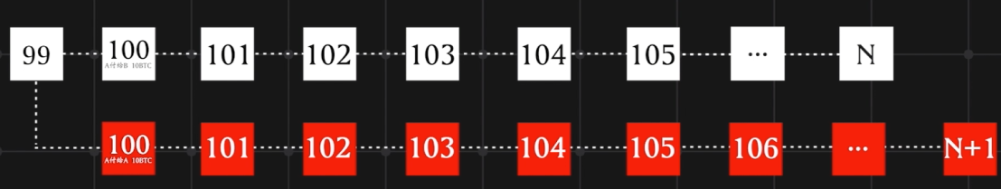
Double-spending
Longest chain first principle
Block 100: A pays B 10BTC
New Block 100: A pays A 10BTC

Slide 31
1. Lack of third party protection(for example banks)
2. Lack of privacy
3. Fraud risk
4. Legal Risk
5. Risk of key loss

Slide 32
PART 4 Application of blockchain in China

Slide 33
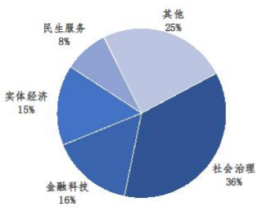
From the "China Blockchain Innovation Application Development Report (2023)" we can conclude that in China blockchain is used in important fields such as the real economy, social governance, people's livelihood services, and financial technology.
people's livelihood services
other
real economy
financial technology
social governance

Slide 34
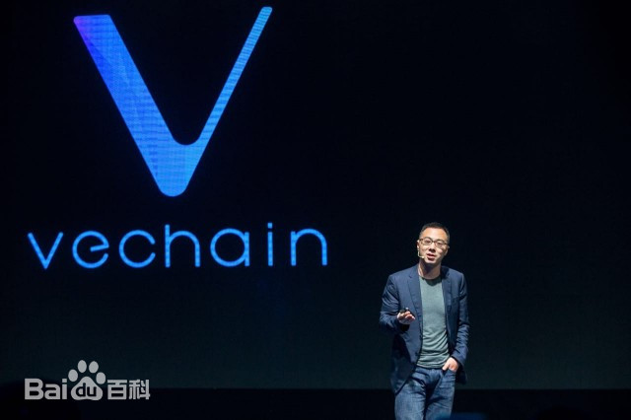
VeChain（唯链）
VeChain is a commodity ID management cloud platform based on blockchain technology
VET (VeChain Token), as the native token on the VeChain blockchain platform, adopts a unique consensus mechanism to ensure the efficiency and reliability of the system.
VET's consensus mechanism is called the "PoA + PoS" mechanism
The VET consensus mechanism ensures the security and stability of the blockchain network
The design of the VET consensus mechanism makes the blockchain system more reliable and efficient.

Slide 35
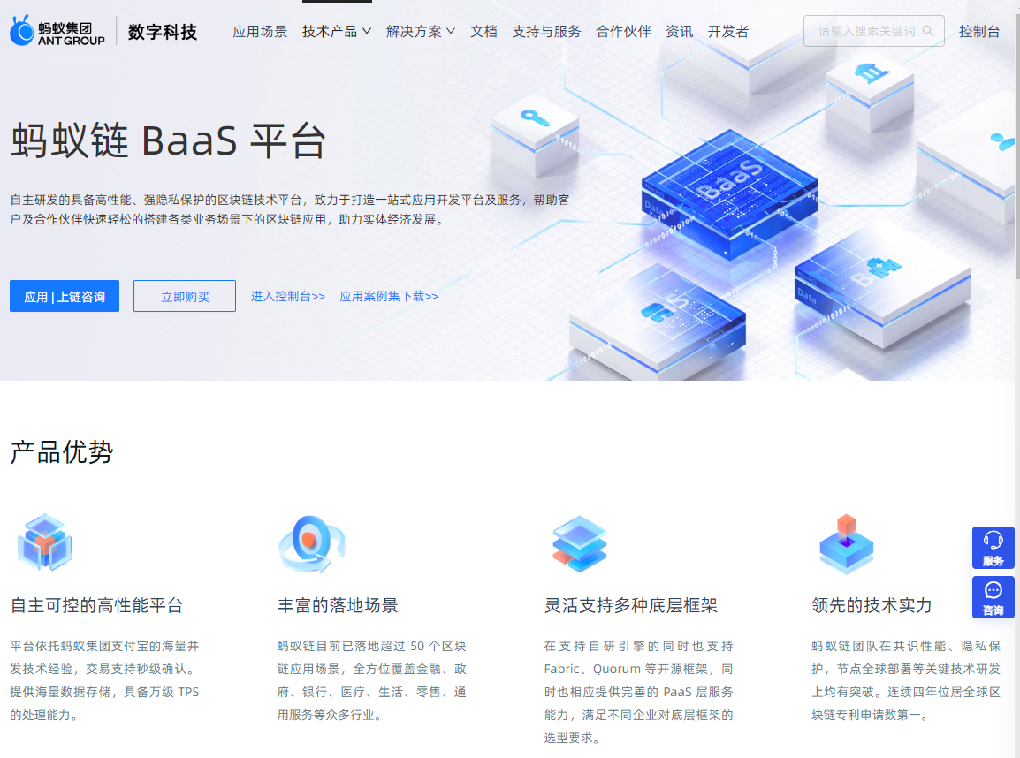
Alibaba Cloud Blockchain as a Service (BaaS) is a blockchain platform service based on mainstream technology, with technical support provided by the Ant Blockchain team.
Supports mainstream blockchain technologies Hyperledger Fabric, enterprise Ethereum Quorum, and Ant Blockchain with core technical capabilities
Cross-region: business participants can be distributed in different regions to achieve the establishment of cross-regional networks
Isolation: The alliance chain network created based on Alibaba Cloud blockchain services ensures the independence of blockchain business participants

Slide 36
BLOCKCHAIN
thank you for listening
Speaker：Е Хэн
Group：P33111

